Slide 1
Evaluating various local thresholding methods on corrupted document images
Group 5 | Project 3
Simone Santoro, Leonardo Conti, Madhur Pratap Singh, Shervin Vahidian Qazvini, Mohammadamin Abdoli, Ashkan Soori and Mohammad Zain

Slide 2
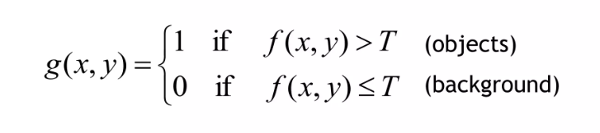
Image Binarization
Refers to allotting all pixels in an image either 0 or 1 value.
When T depends on intensity statistics of entire image ->
Global Threshold
When T depends on intensity statistics of local neighbourhood ->
Local Threshold

Slide 3
Thresholding Techniques
Singh’s Method
Niblack’s Method
Sauvola’s Method
Bernsen’s Method
Otsu Thresholding
Zhang’s Thresholding

Slide 4
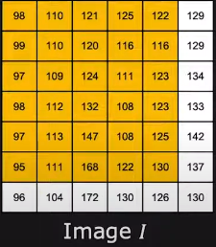
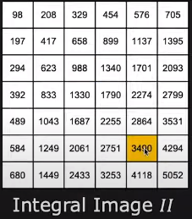
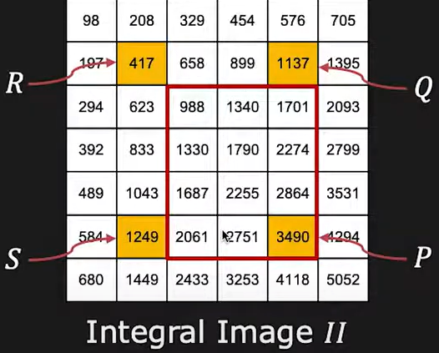
Integral Sum Image
Sum = II_{P} – II_{Q} – II_{S} + II_{R}
= 3490 – 1137 – 1249 + 417 = 1521
Computational Cost = 3 operations

Slide 5
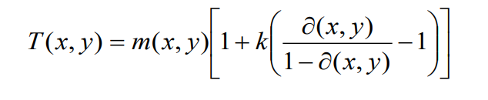
Singh’s Method
Convert greyscale image to an integral sum image
T is calculated using the formula for each pixel in a window:
where m(x,y) is the local mean, ∂(x,y)=I(x,y) - m(x,y) is the local mean deviation, and k is bias with range [0,1]
Singh, T. Romen, et al. "A new local adaptive thresholding technique in binarization." arXiv preprint arXiv:1201.5227 (2012).

Slide 6
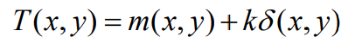
Niblack’s Method
T(x,y) is calculated as:
where m(x,y) and δ(x,y) are the local mean and standard deviation of the pixels inside the window w x w and k is bias.
Niblack Wayne. An Introduction to Digital Image Processing. Prentice-Hall International 1986.

Slide 7
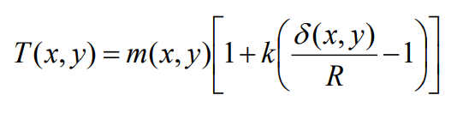
Sauvola’s Method
We again use mean m(x,y) and standard deviation δ(x,y) within a window size w x w as:
R here is the maximum value of the standard deviation
R = 128 for a greyscale document
k is a bias which takes values between [0.2, 0.5]
Sauvola, Jaakko, and Matti Pietikäinen. "Adaptive document image binarization." Pattern recognition 33.2 (2000): 225-236.

Slide 8
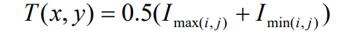
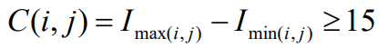
Bernsen’s Method
T(x,y) is calculated at (x,y) within a window size w x w as:
where I_{max(i,j)} and I_{min(i,j)} are maximum and minimum gray values within the local window, provided contrast:
John Bernsen. “Dynamic thresholding of gray-level images.” Eighth International Conference on Pattern Recognition. Proceedings, 1986, p. 1251-1255

Slide 9
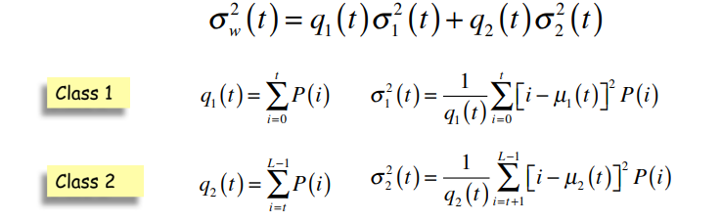
Otsu Thresholding
Described as a global thresholding method, it minimizes the within group variance between background and object group
Kurita, Takio, Nobuyuki Otsu, and N. Abdelmalek. "Maximum likelihood thresholding based on population mixture models." Pattern recognition 25.10 (1992): 1231-1240.

Slide 10
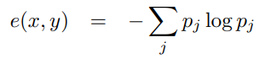
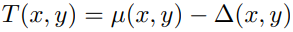
Zhang’s Method
At each pixel location (x,y), local mean µ(x,y) , standard deviation σ(x, y) and entropy defined as e(x,y) within W are calculated such that,
e(x,y) = - ∑ p_{j} log p_{j}
Where p_{j} Is the probability that pixels within W take value j.
Based on local mean and a locally adaptive offset, T(x,y) is computed as:
Where ∆(x,y) is defined as:
∆(x,y) = e² (x,y) / σ(x, y)
Zhang, Min, et al. "Entropy-Based Locally Adaptive Thresholding for Image Segmentation." Available at SSRN 4010416 (2022).

Slide 11
Quantitative Parameters
Peak Signal-to-Noise Ratio
Structural Similarity Index Measure
Multiscale Structural Similarity Index Measure

Slide 12
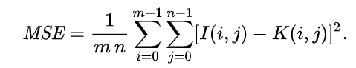
PSNR
Peak Signal-to-Noise Ratio is ratio between maximum possible power of a signal and the power of corrupting noise.
Used to quantify reconstruction quality of (lossy) compressed images.
Given a noise-free m×n monochrome image I and its noisy approximation K, MSE and then PSNR are defined as:
Egiazarian, Karen, et al. "New full-reference quality metrics based on HVS." Proceedings of the second international workshop on video processing and quality metrics. Vol. 4. 2006.

Slide 13
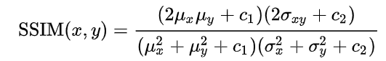
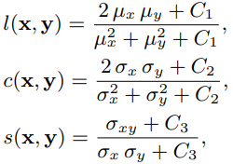
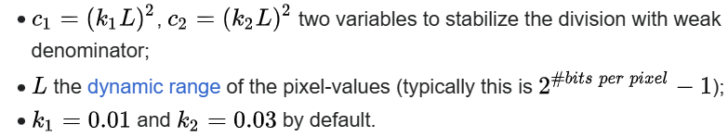
SSIM
Structural Similarity Index Measure; similarity between 2 images.
Structural Information is the idea that spatially close pixels have strong inter-dependencies.
For two windows x and y of common size N x N,
Wang, Zhou, et al. "Image quality assessment: from error visibility to structural similarity." IEEE transactions on image processing 13.4 (2004): 600-612.

Slide 14
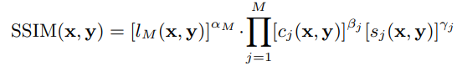
MSSIM
Multiscale SSIM system iteratively applies a low-pass filter and down samples the filtered image by a factor 2.
Original image is indexed as scale 1 and highest scale as scale M (obtained after M – 1 iterations)
At the j^{th} scale, contrast comparison and structure comparison are calculated and denoted as c_{j}(x,y) and s_{j}(x,y) respectively. Luminance comparison is computed only at scale M and is denoted as l_{M}(x,y).
Overall SSIM is represented as:
Wang, Zhou, Eero P. Simoncelli, and Alan C. Bovik. "Multiscale structural similarity for image quality assessment." The Thrity-Seventh Asilomar Conference on Signals, Systems & Computers, 2003. Vol. 2. Ieee, 2003.

Slide 15
Dataset
Ground truth
Corrupted images
10 document binarized images (1221x1580).
Obtained applying non-uniform luminosity.

Slide 16
Project Methodology
Developed a MATLAB algorithm that performed all the techniques with a range of possible parameter combinations on the corrupted dataset;
Evaluated the performance of every threshold;
The values for all the metrics relative to the same parameter set computed on different images were averaged;
Analysed the validity of the mean through Kruskal-Wallis test;
Identified the best performing techniques.

Slide 17
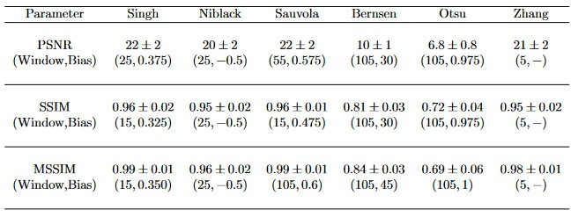
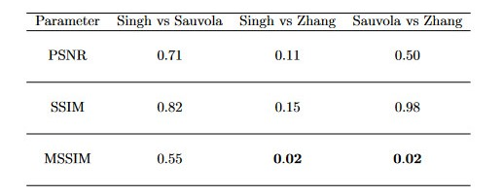
Results
Notes:
Probability that si vs …. An vs… come from same distribution

Slide 18
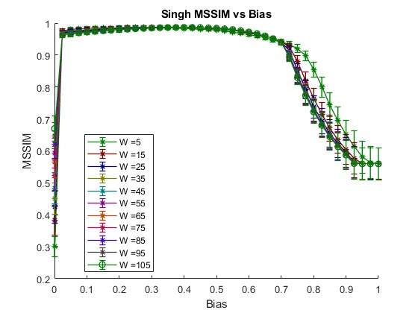
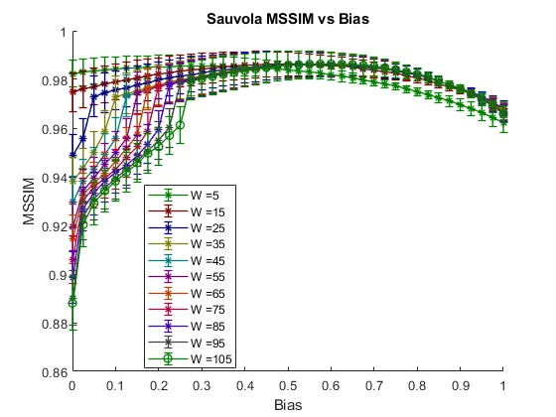
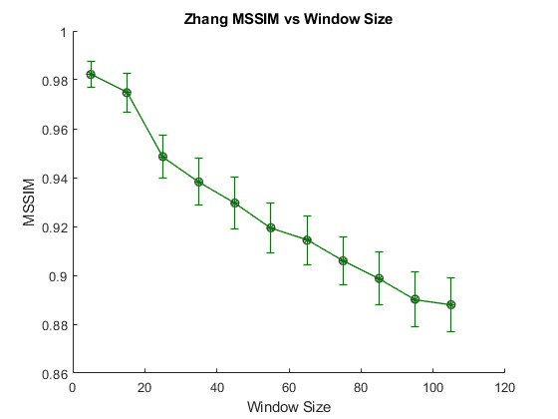
Visual representation

Slide 19
Obtained thresholds
Corrutped image
Singh threshold
(15,0.35)
Sauvola threshold
(105,0.6)

Slide 20
Conclusions
From Kruskal-Wallis test we found out that:
It is not possible to determine the best algorithms by PSNR and SSIM;
Using MSSIM we can conclude that both Singh and Sauvola perform better than Zhang;
It is not possible to differentiate the performance between Singh and Sauvola methods.
Notes:
Say that singh is faster then sauvola.

Slide 21
THANK YOU

